Slide 1
Convolutional Neural Network

Slide 2
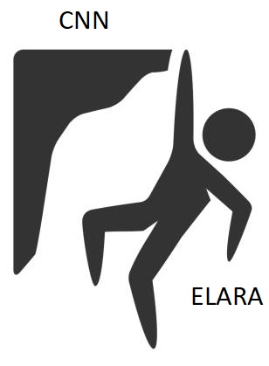

Slide 3
Agenda
Problems we are facing
What is a Neural Network?
How can we train a Neural Network?
What is a Convolutional Neural Network?
My master’s project
Live demo
Open discussion
30 minutes
25 minutes

Slide 4
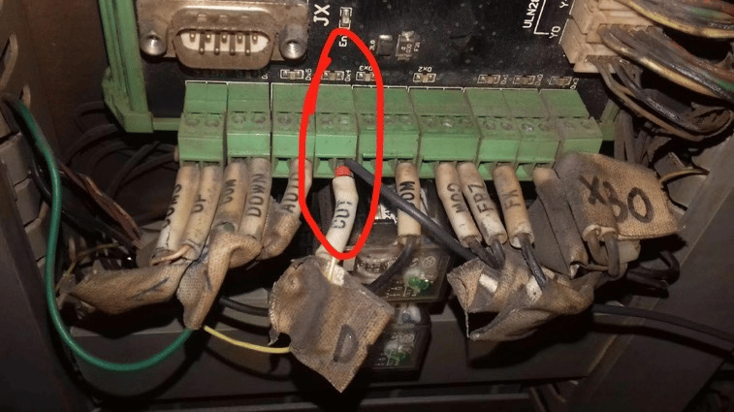
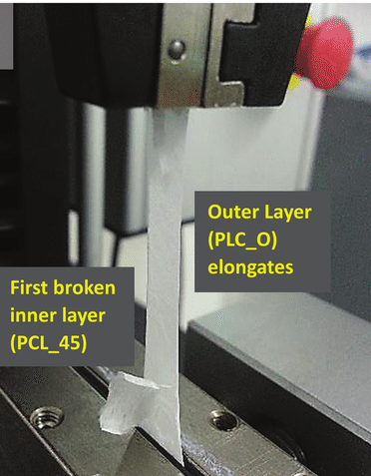
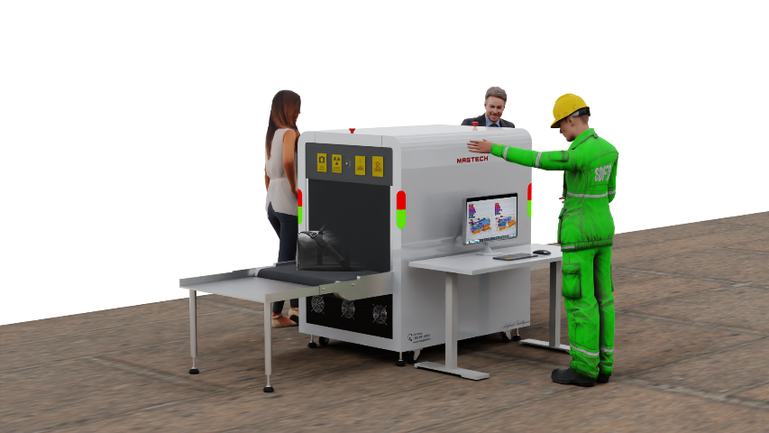
Problems we are currently facing
Predictive maintenance
Security scanning

Slide 5
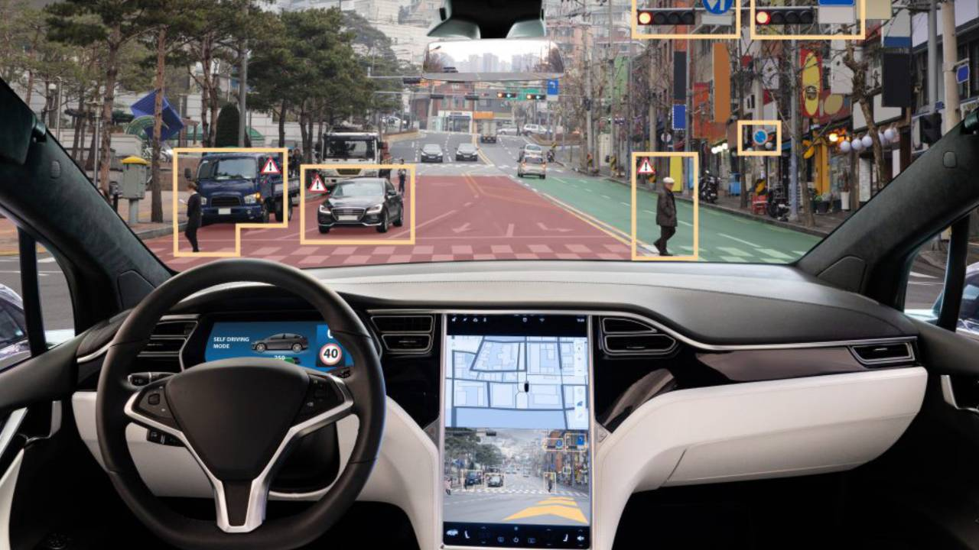
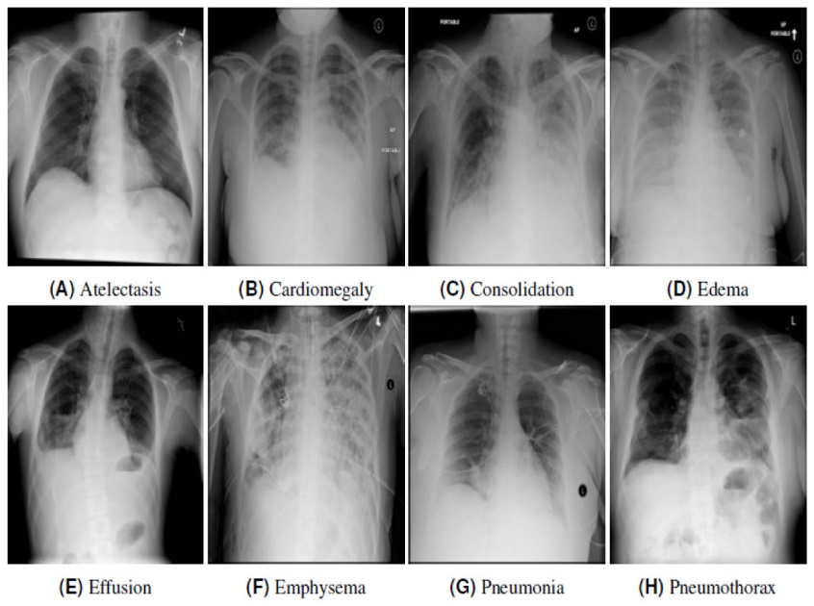
Problems we are currently facing
Self-driving cars
Xray

Slide 6
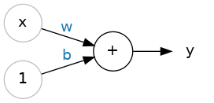
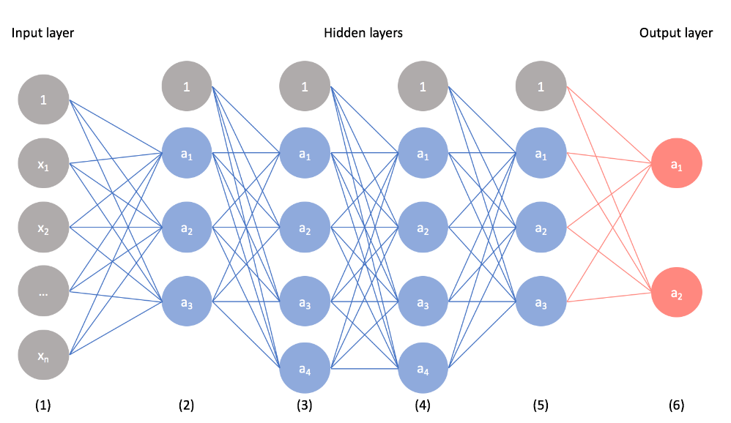
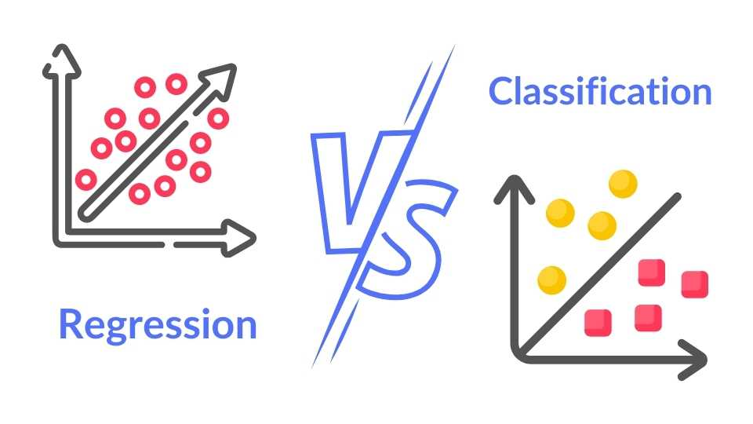
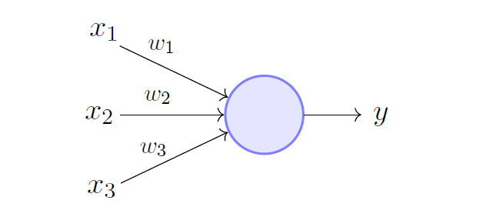

What is a Neural Network?
$y=wx+b$
$y=w_{1}x_{1}+w_{2}x_{2}+w_{3}x_{3}+(b)$
$y=wx+b$
$y=w_{1}x_{1}+w_{2}x_{2}+w_{3}x_{3}+(b)$
Perceptron – Single neuron neural network
Neural network – Multi-layered perceptron
Notes:
For each neuron, there is an activation function (given the input, how to compute the output)
Simplest form is sigmoid function
Another common one is SoftMax, which limits the output to 0-1
Two common usecase could be regression and classification
Regression:
Finding the salary based on years of experience
Finding the salary based on years of experience, age, education, country, degree
Find out the age expectancy given the number of cigarets smoked daily
Classification:
Given an image, determine whether

Slide 7
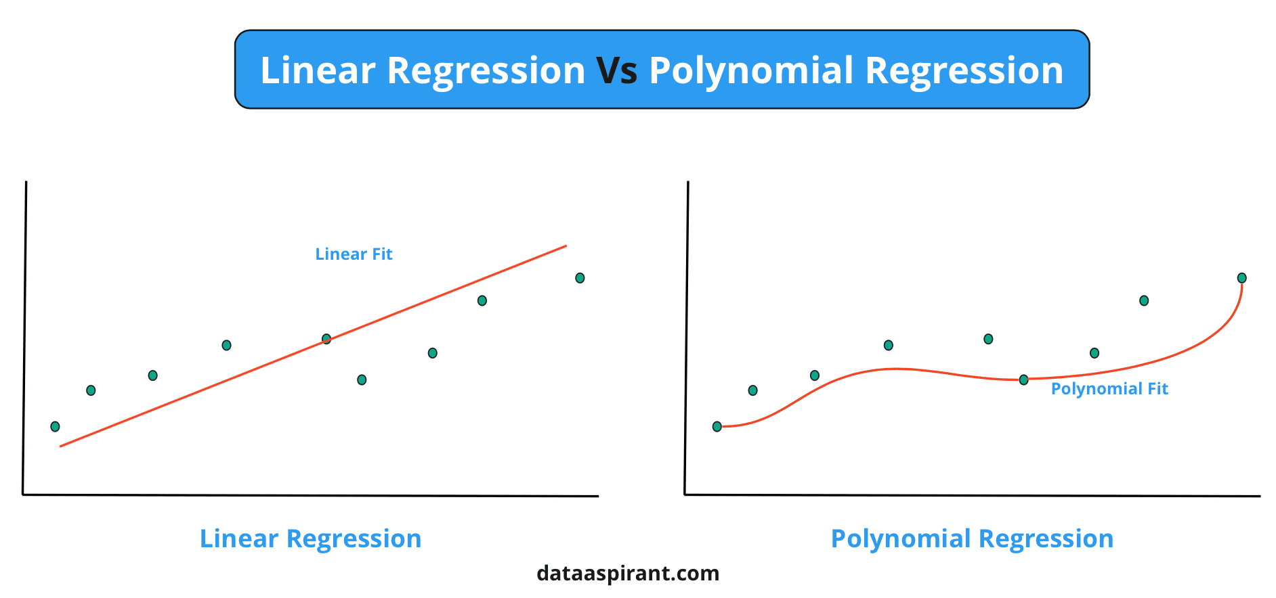


How can we train a Neural Network?
$y=wx+b$
Methods:
Regression
Least squared
Matrix
$y=w_{1}x_{1}+w_{2}x_{2}+w_{3}x_{3}+(b)$

Slide 8
How can we train a Neural Network?
How about deep neural networks?
Randomly initialize weights
Input data (that we already know the result of)
Forward pass
Calculate error
Backpropagation (find which weights contributed to the lost the most)
Update Weights
Repeat 2-6 for all input data
Repeat step 2-7 multiple times (epoch)

Slide 9
How can we train a Neural Network?

Slide 10
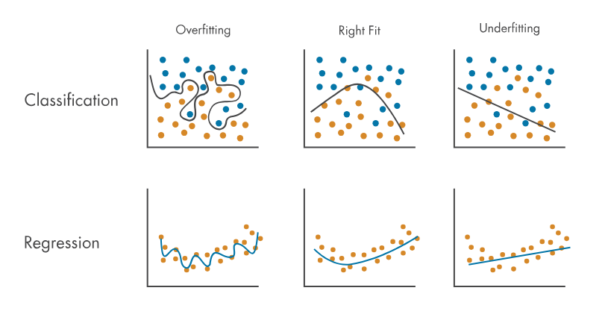
How can we train a better Neural Network?
More data
Finetuning
Adjusting loss function
Learning rate
Epoch (Number of iterations to train a neural network)
Different loss functions
Adjust model
Adjust model depth
Adjust model architecture
The classic problem in machine learning: Overfitting

Slide 11
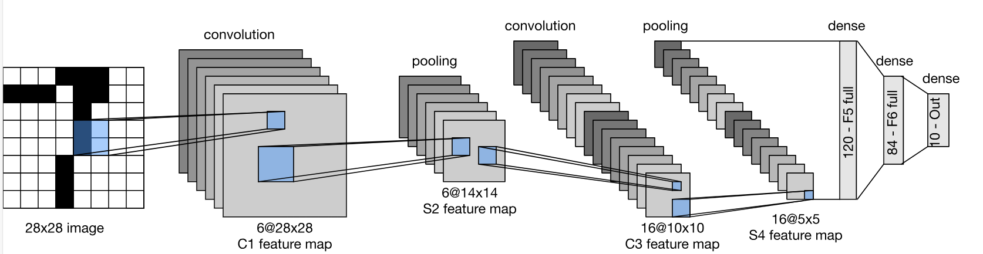
What is a Convolutional Neural Network?
For images, we can simply input all pixel values in the input layer
Problem
Too many inputs
256 x 256 x 3 = 196,608 inputs
Translation invariance
Local feature learning
Notes:
What are the weights in the above example?

Slide 12
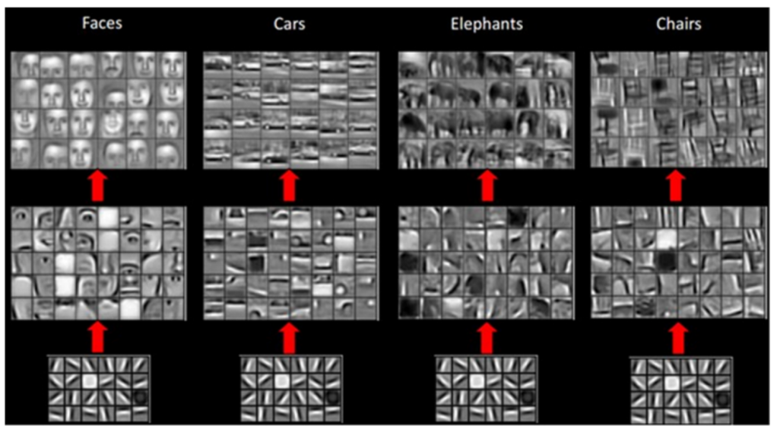
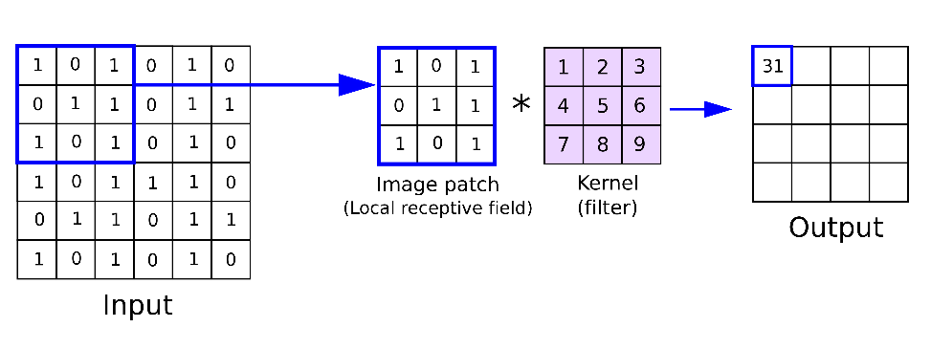
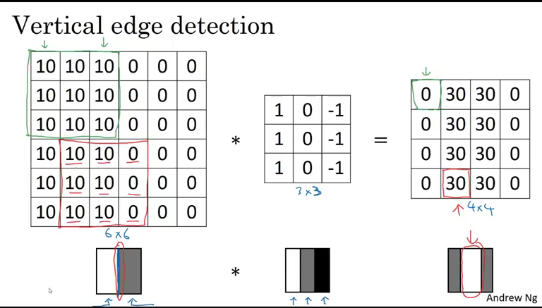
What is a Convolutional Neural Network?
Notes:
Lower layers eventually trained to become line detection
Later layers become feature detection

Slide 13
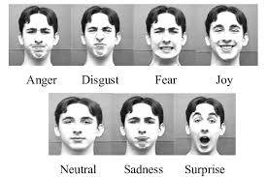
My master’s project
7 basic emotions according to a study by Albert Mehrabian in 1981
Can we distinguish what emotion someone is feeling with CNN?

Slide 14
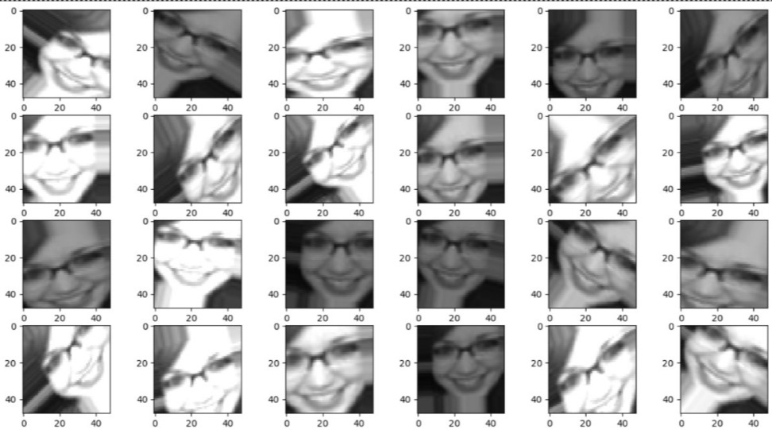

My master’s project
Trained on 36,000 48x48 greyscale images of human faces
Used pretrained models – facenet
Use image augmentation techniques to reduce overfitting
70% Accuracy

Slide 15
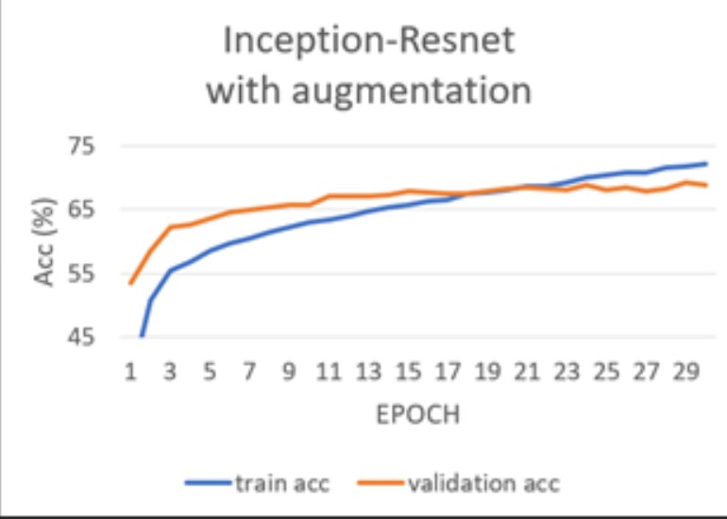
My master’s project

Slide 16
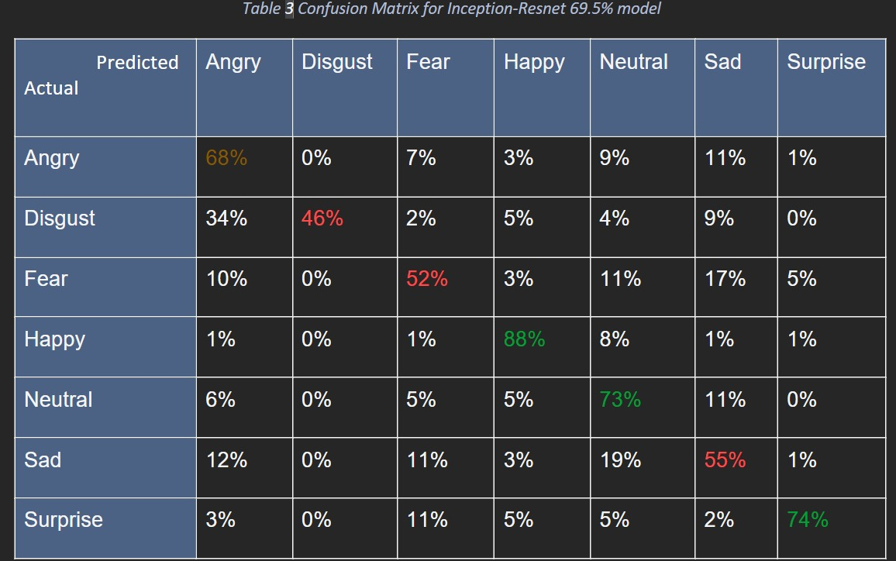
My master’s project

Slide 17
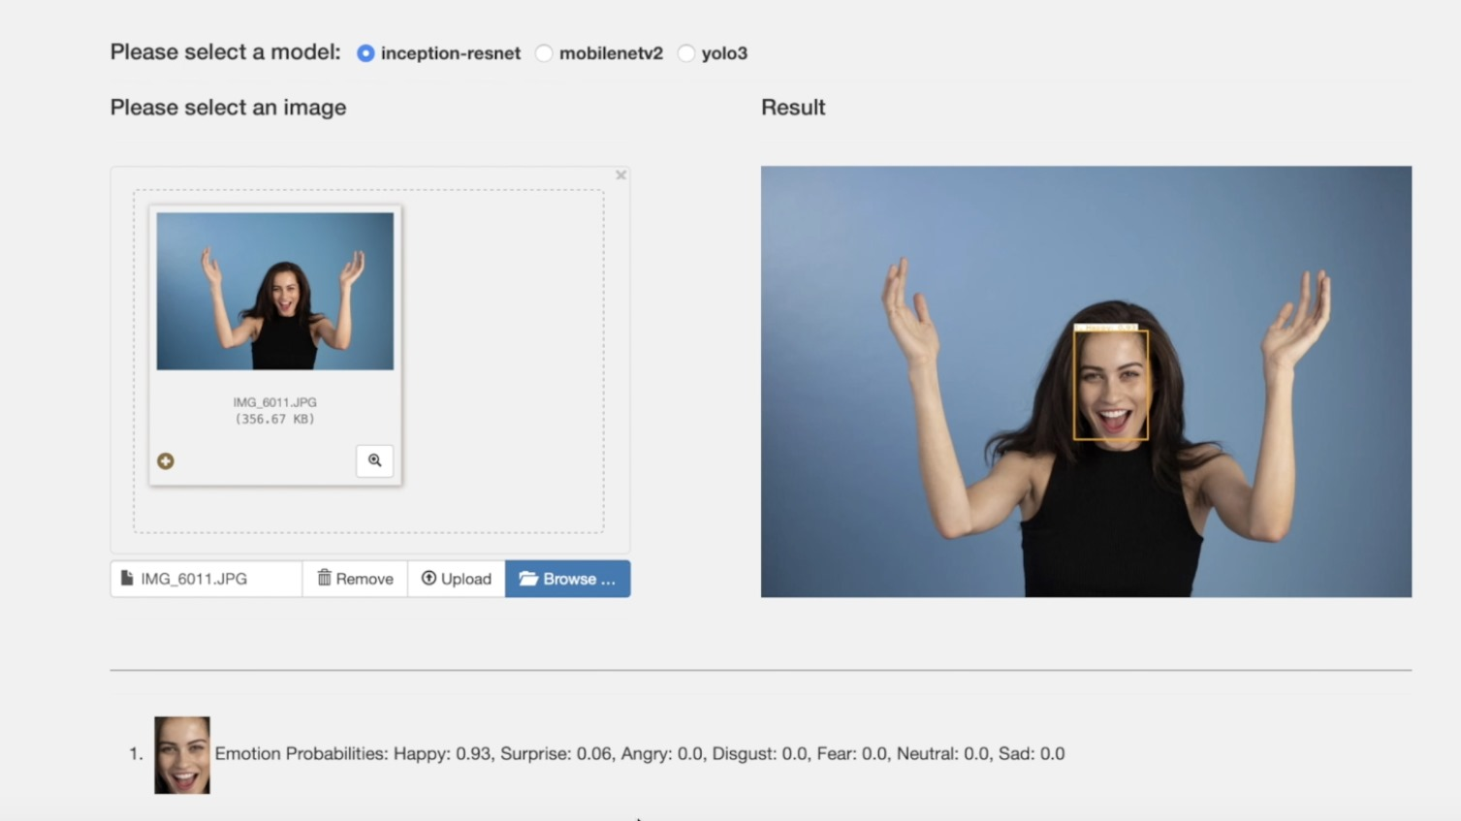
My master’s project

Slide 18
Live demo
Only trained on 4709 images
Less accurate at 51%
Backup: https://www.youtube.com/watch?v=IIOCuh2Vh9g&t=177s

Slide 19
Problems we are currently facing
Predictive maintenance
Security scanning

Slide 20
Questions

Slide 21
Open discussion
Is CNN going to be outdated?
ChatGPT is a neural network that predicts the next word, similar to classification of emotions
Uses a new technique called transformers (attention mechanism)
For me
ChatGPT is useful for learning/explaining concepts, debugging code, CICD pipelines, writing boilerplate
ChatGPT is less useful for writing long pieces of code with complex logic, and usually makes some mistakes
ChatGPT is not useful for getting knowledge outside of “common” knowledge
We are seeing a lot of AI generated content on Youtube, Google. How do you feel about this?
Where do we see neural networks in 10, 20, 50, 100, 1000 years?

Slide 22
Finally…
Training the models are computationally expensive and can generate significant workloads
How can we ensure they run smoothly as we push the limits of Machine Learning/AI (in Elastic search)?
AI & ML Search Engine - Take Search to the Next Level | Elastic
Stay tuned next week…

